Slide 1
Time Series Analysis of Tweets’ Sentiment
Samiul Islam

Slide 2
Research Objective
Understand how tweet’s sentiment (polarity) changes over time

Slide 3
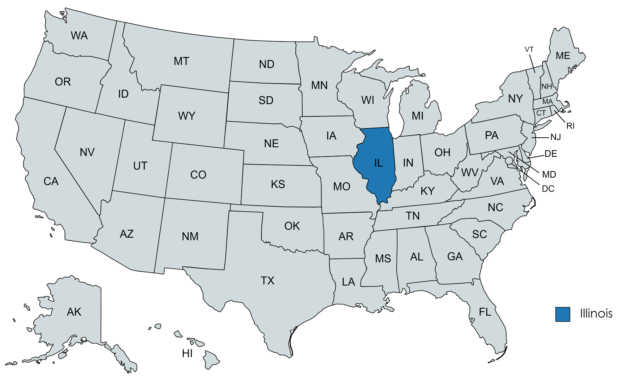
Dataset
Twitter data
IL
Ranges between May 16, 2014 to the end of the year
20,237,711 tweets

Slide 4
Dataset(s)
Surnames data (Race Resolution)
Baby-names data (Gender Resolution)
Race Specific Income (county level)
-> Illinois has approx. 6 million tweets of those 20+ million after resolutions

Slide 5
Aggregating Sentiments to form the Time Series Data
Hourly Data vs Daily Data
Aggregating the sentiment metrics (positive and negative polarity) accordingly

Slide 6
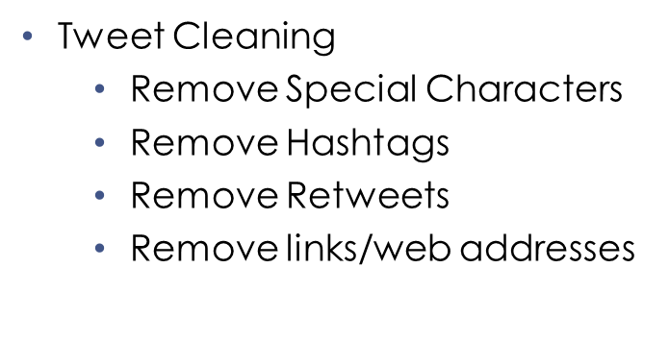
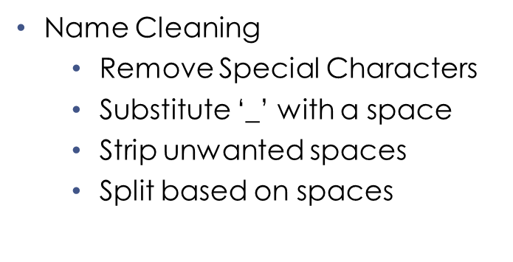
Assumptions

Slide 7
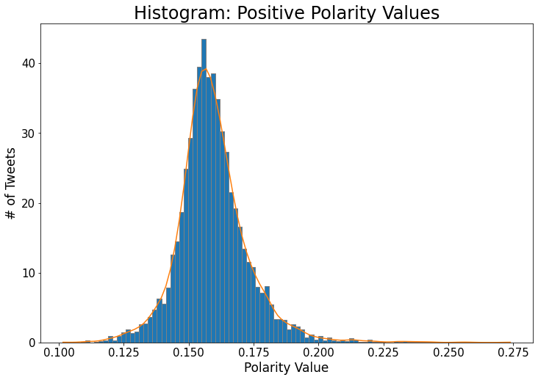
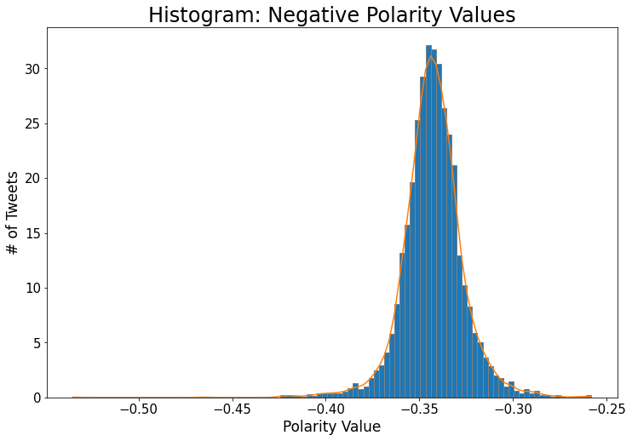
Data Statistics
5347 hourly entries for both positive and negative polarities
Mean: 0.159342087
Median: 0.158017043
Mean: -0.342721088
Median: -0.342882594

Slide 8
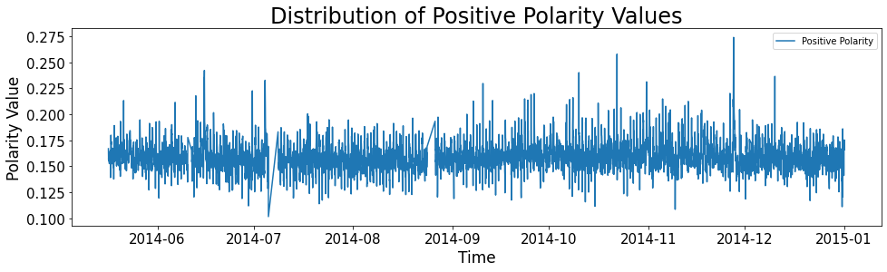
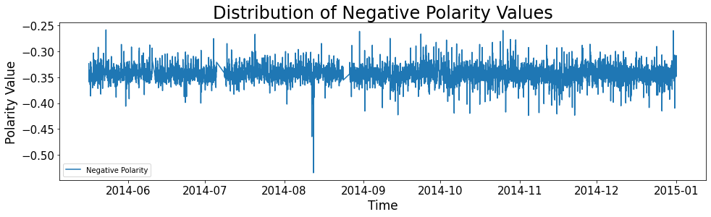
Data Distribution

Slide 9
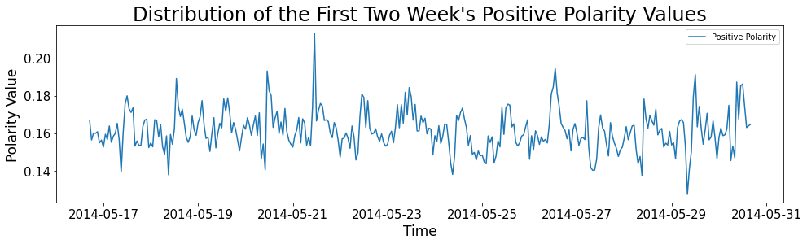
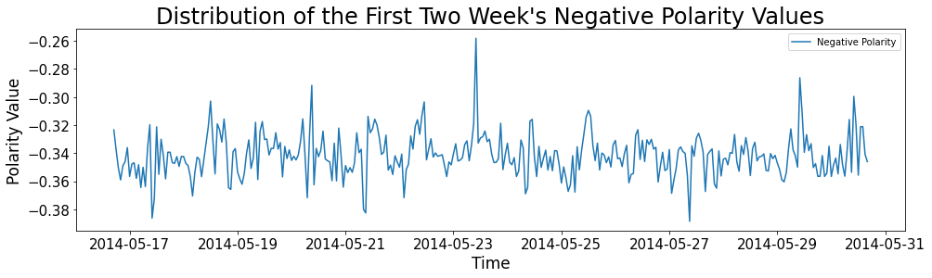
Data Distribution

Slide 10
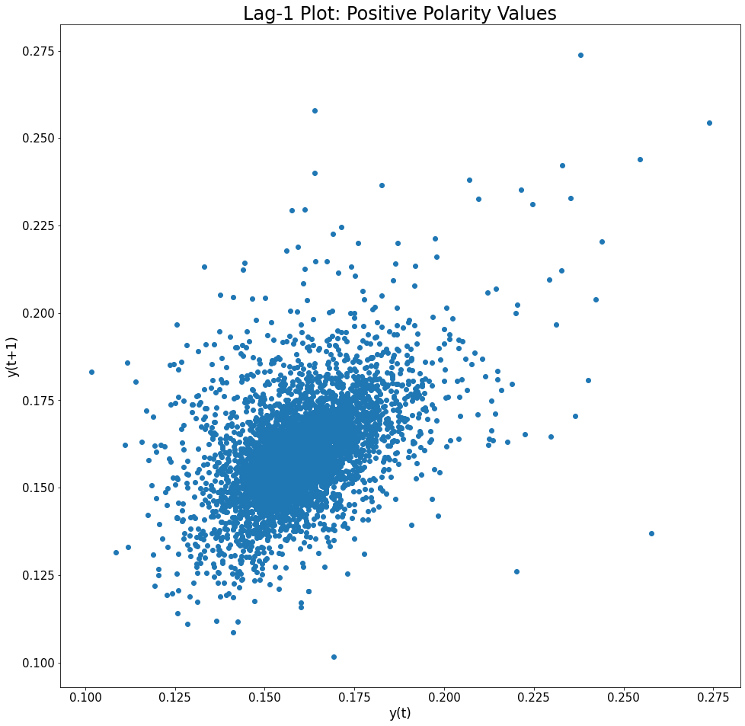
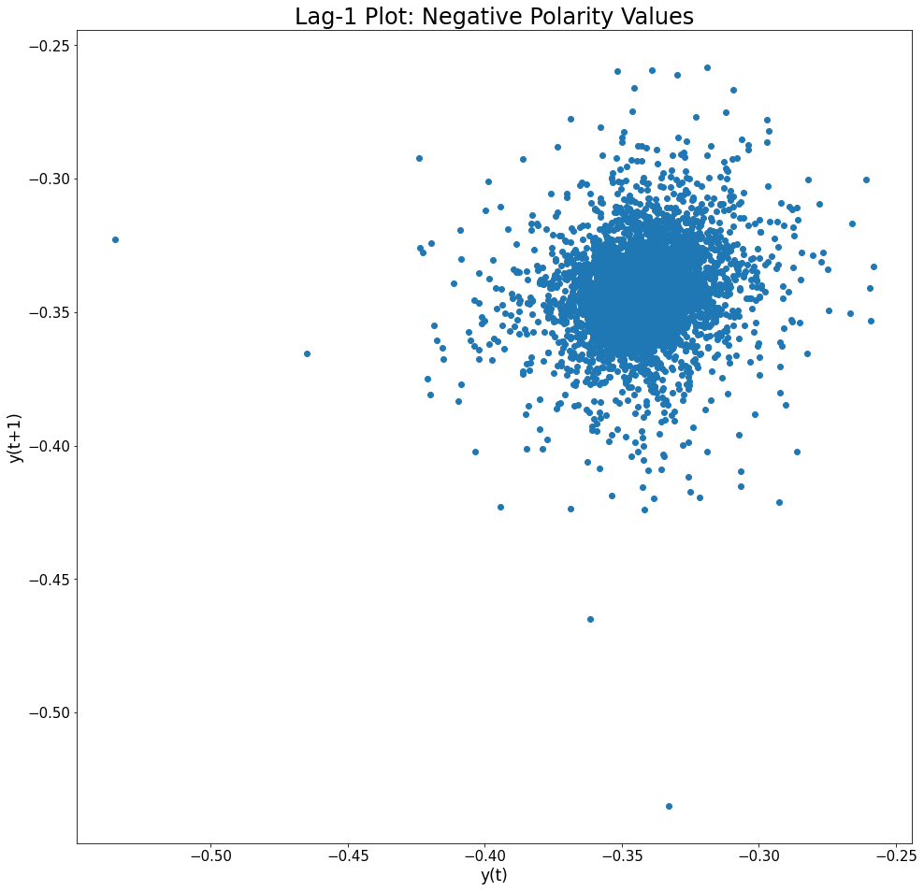
Lag Plots

Slide 11
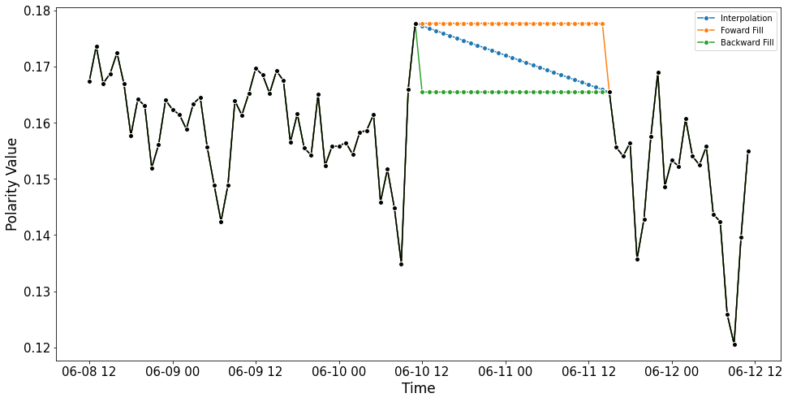
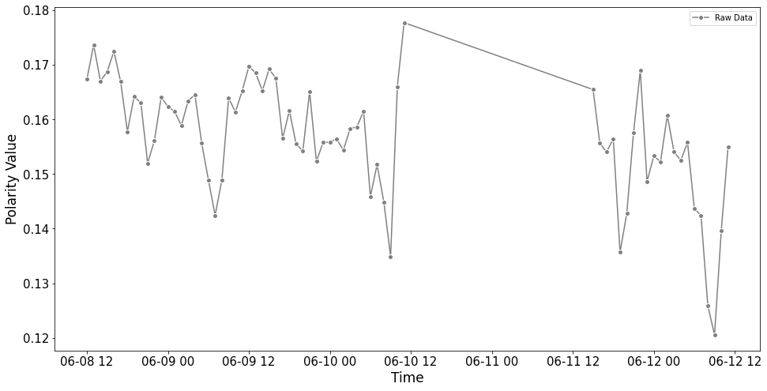
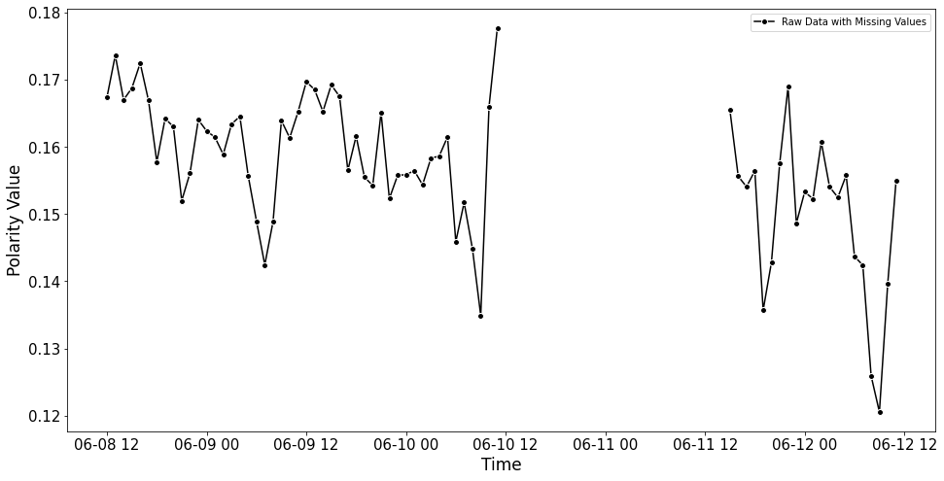
Missing Value
There are 161 missing value(s)!
Approaches to handle those:
Interpolation
Forward Fill
Backward Fill

Slide 12
Methodology
Positive Polarity
Negative Polarity
Allows Missing Values
Missing Value Handler
Allows Missing Values
Missing Value Handler
Inter-polation
Inter-polation
Forward
Fill
Forward
Fill
Backward Fill
Backward Fill

Slide 13
Data Stationarity Test
ADF Test
All the eight versions of the dataset has been tested and the p-value remained well below the 0.05 significance level.
KPSS Test
Supports the output of the ADF test.
Backward Filled Positive Polarity Data seemed to disagree.

Slide 14
Set of Models
Simple Models
Regression Models
ARIMA Models
Naïve
Average (1 & 4 Weeks)
Seasonal Naïve (1 & 4 Weeks)
Drift (1 & 4 Weeks)
Rolling Average (1 & 4 Weeks)
Linear Regression
Support Vector Regression
K Neighbors Regression
Decision Tree Regression
Random Forest Regression
Auto ARIMA with Stepwise Implementation
Auto ARIMA without Stepwise Implementation
Set-aside 1080 entries for testing (45 days; approx. 20% of the data)

Slide 15
Performance Metrics
R-squared
MAE
MAPE
MSE
RMSE
NRMSE
ME
MPE

Slide 16
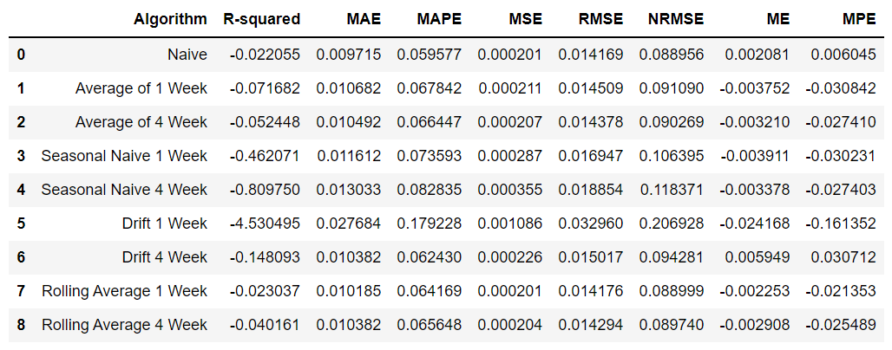
Simple Models Evaluation
Performance Comparison (allows missing value)

Slide 17
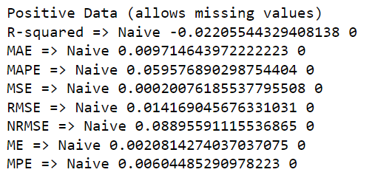
Simple Models Evaluation (Best Performer)

Slide 18
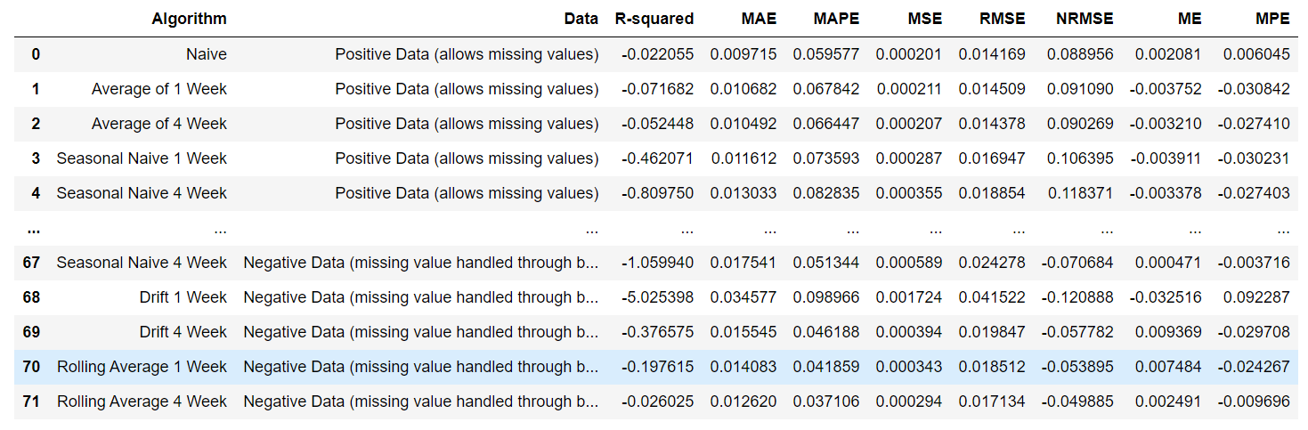
Simple Models Evaluation (Combined)
Performance Comparison

Slide 19
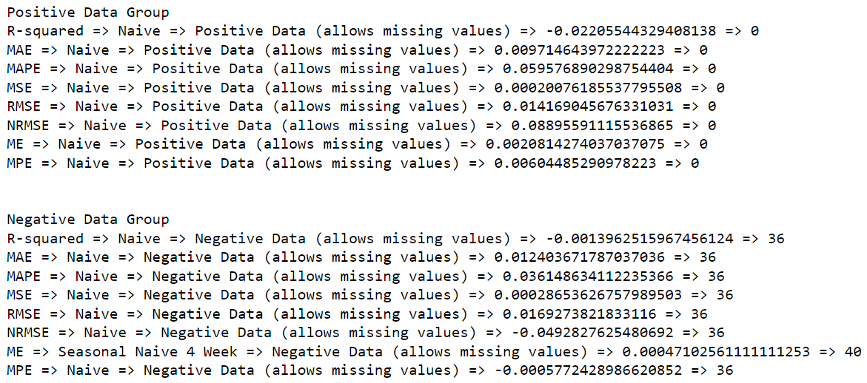
Simple Models Evaluation (Best Performer)

Slide 20
For both the positive and negative data, the naive method where I used the last observation from the training set to predict or estimate the future worked best regardless of data-cleaning.

Slide 21
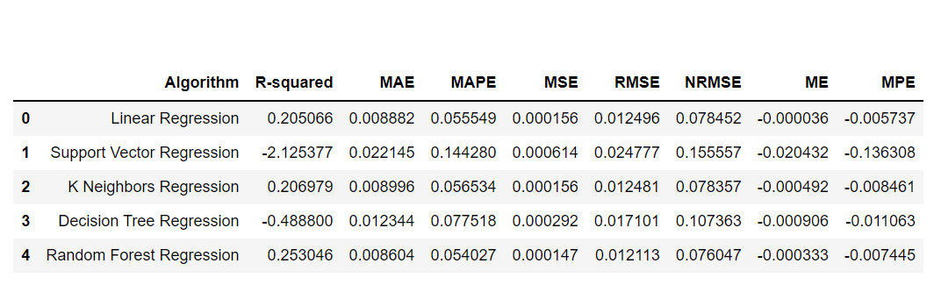
Regression Models Evaluation
Performance Comparison (allows missing value)

Slide 22
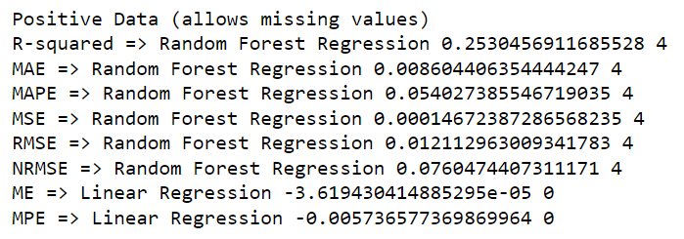
Regression Models Evaluation (Best Performer)

Slide 23
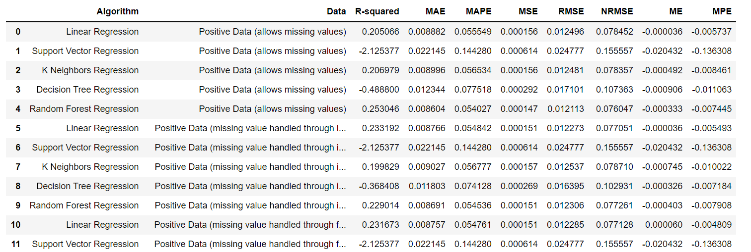
Regression Models Evaluation (Combined)
Performance Comparison
.
.
.

Slide 24
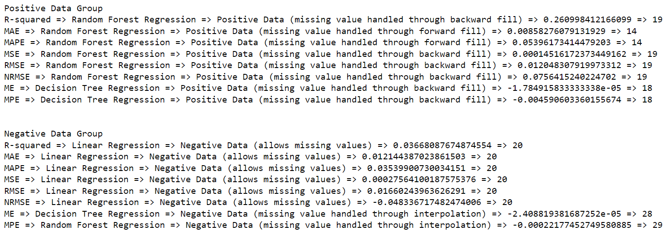
Regression Models Evaluation (Best Performer)

Slide 25
For the positive data, it seems that handling missing values using forward fill works in the favor of prediction when I use Random Forest.
For the negative data, it can be used as-is but if we want to handle the missing values, we should use interpolation this time. As an algorithm, if we fill the data using interpolation, we should use Random Forest; however, raw data in combination to linear regression works the best.

Slide 26
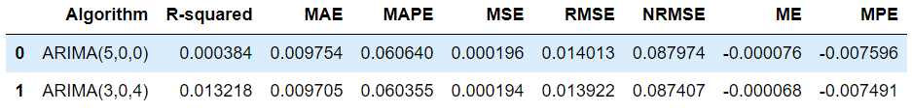
ARIMA Models Evaluation
Performance Comparison (allows missing value)

Slide 27
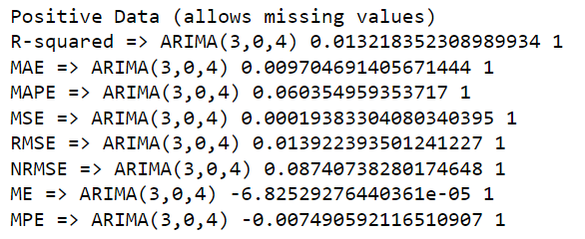
ARIMA Models Evaluation (Best Performer)

Slide 28
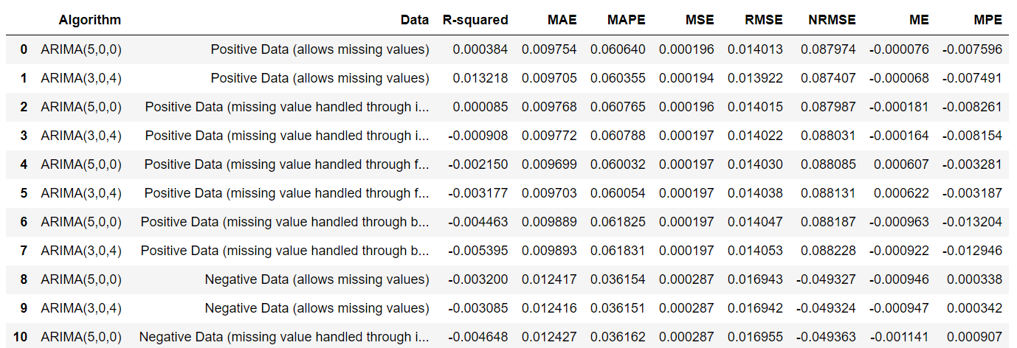
ARIMA Models Evaluation (Combined)
Performance Comparison
.
.
.

Slide 29
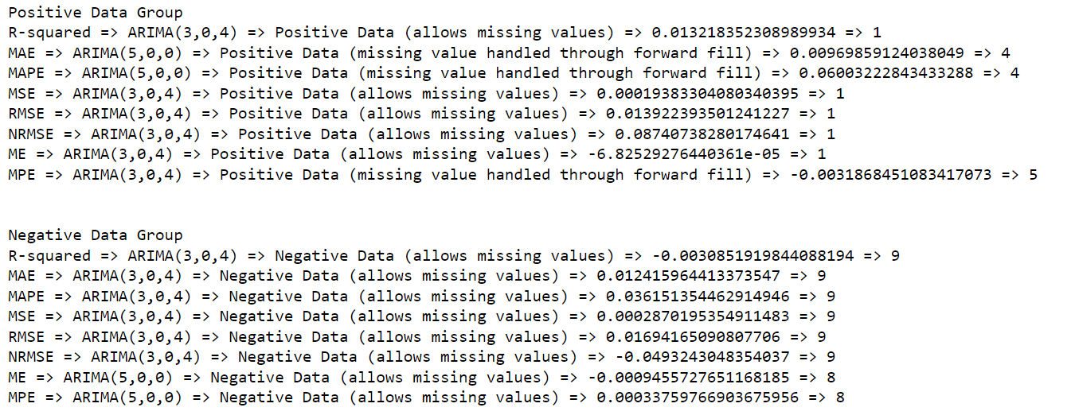
ARIMA Models Evaluation (Best Performer)

Slide 30
For positive data, ARIMA(3,0,4) tends to perform better with raw data whereas ARIMA(5,0,0) gets benefited if we use forward fill to handle missing values.
For negative data, ARIMA (3,0,4) performs well with raw data.

Slide 31
Final Thoughts?
For positive polarity data, the best performers from each groups are:
Simple: Naïve with any of the four data
Regression: Random Forest with Forward Fill
ARIMA: ARIMA(3,0,4) with raw data
and ARIMA(5,0,0) with Forward Fill
Algorithm | R-squared | MAE | MAPE | MSE | RMSE | NRMSE | ME | MPE
Naive | -0.02206 | 0.009715 | 0.059577 | 0.000201 | 0.014169 | 0.088956 | 0.002081427 | 0.006044853
Random Forest Regression | 0.253839 | 0.008583 | 0.053962 | 0.000147 | 0.012107 | 0.076007 | -0.000540228 | -0.008733587
ARIMA(3-0-4) | 0.013218 | 0.009705 | 0.060355 | 0.000194 | 0.013922 | 0.087407 | -6.83E-05 | -0.007490592
ARIMA(5-0-0) | -0.00215 | 0.009699 | 0.060032 | 0.000197 | 0.01403 | 0.088085 | 0.000606572 | -0.003281259

Slide 32
Final Thoughts?
For negative polarity data, the best performers from each groups are:
Simple: Naïve with any of the four data
Regression: Random Forest with Interpolation
ARIMA: ARIMA(3,0,4) with raw data
Algorithm | R-squared | MAE | MAPE | MSE | RMSE | NRMSE | ME | MPE
Naive | -0.0014 | 0.012404 | 0.036149 | 0.000286536 | 0.016927 | -0.04928 | -0.000632075 | -0.000577243
Random Forest Regression | -0.00495 | 0.012292 | 0.035729 | 0.000287552 | 0.016957 | -0.04937 | -0.000720464 | -0.000221775
ARIMA(3-0-4) | -0.00309 | 0.012416 | 0.036151 | 0.00028702 | 0.016942 | -0.04932 | -0.000946872 | 0.000341534

Slide 33
Going Forward…
How these distribution changes when we group tweets by topics?
How does it impact the other region?
How these distribution changes when we group users by their demographics characteristics?

Slide 34
Thank you! Questions?

